Slide 1


PROJECT WORK – First Review
LIFE SHARE
NAMALA ADITHYA DWARAK (412620243015)
PRIYADHARHINI P (412620243019)
SRILEKHA S (412620243025)
Supervisor
Mr. S. Anburaman
Head of Department
Department of Artificial Intelligence and Data Science.

Slide 2
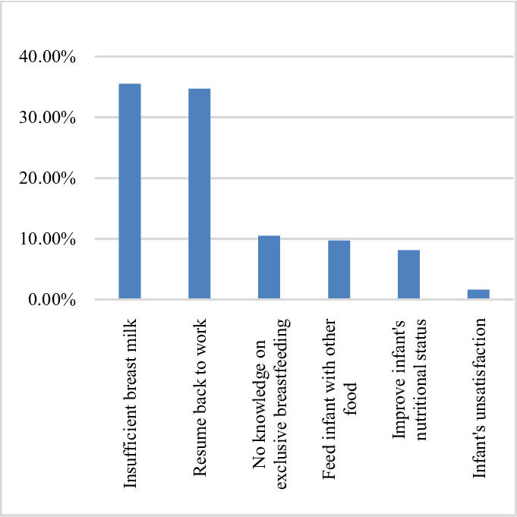
Problem Statement:
According to recent estimates, only around two-fifths (43%) of children born in the six months preceding the survey were breastfed within one hour of delivery, indicating that more than half (57%) of them had delayed breastfeeding. In India, 63% of infants under the age of six months are non-exclusively breastfed. Many children under the age of six months consume other liquids, such as plain water (10%), other milk (8%), or complementary foods (11%), in addition to breastmilk [21].

Slide 3
ABSTRACT OF THE PROJECT
LifeShare is a groundbreaking online platform designed to address the critical need for safe and nourishing essentials for infants in challenging circumstances. Our innovative website serves as a lifeline by connecting breast milk donors, blood donors, and organ donors with infants and individuals in need. Whether it's situations where mothers are unable to provide sufficient milk, individuals are in need of life-saving blood transfusions, or there is a critical need for organ transplants, LifeShare is dedicated to ensuring that every newborn and individual has access to the best start in life and the vital resources they require.

Slide 4
LITERATURE REVIEW
Paper Title: Developing Global Guidance on Human Milk Banking
Year: 2021
Achievement:
Provides comprehensive global guidance on human milk banking.
Focuses on policy development and recommendations for human milk banking practices.
Paper Title: Perception of Donor Breast Milk and Determinants of Its Usage
Year: 2018
Achievement:
Investigates the perception of donor breast milk and explores determinants influencing its usage.
Provides insights into factors that may influence the acceptance and utilization of donor breast milk.

Slide 5
LITERATURE REVIEW
Paper Title: Nearest Blood & Plasma Donor Finding: A Machine Learning Approach
Year: April 2021
Conference: 2020 23rd International Conference on Computer and Information Technology (ICCIT)
Content Highlights:
Introduces a machine learning approach for locating nearest blood and plasma donors.
Specific algorithms used they are k-means clustering , knn clustering.

Slide 6
METHODOLOGY
Project Inception:Define goals for a comprehensive healthcare donation platform.
Architecture Design:Plan the system architecture for React frontend and Java Spring Boot backend.
Frontend Development:Implement user-friendly interfaces with React.
Backend Development:Create secure APIs and backend logic using Java Spring Boot.
Database Integration:Choose MySQL for efficient data storage and Design a schema for donor and recipient information.
Machine Learning Integration:Identify ML algorithms for user matching, fraud detection, and resource allocation and Integrate models for efficient healthcare support.
Testing:Perform unit and integration testing for reliability.
Deployment:Deploy on AWS or Heroku for scalability.

Slide 7
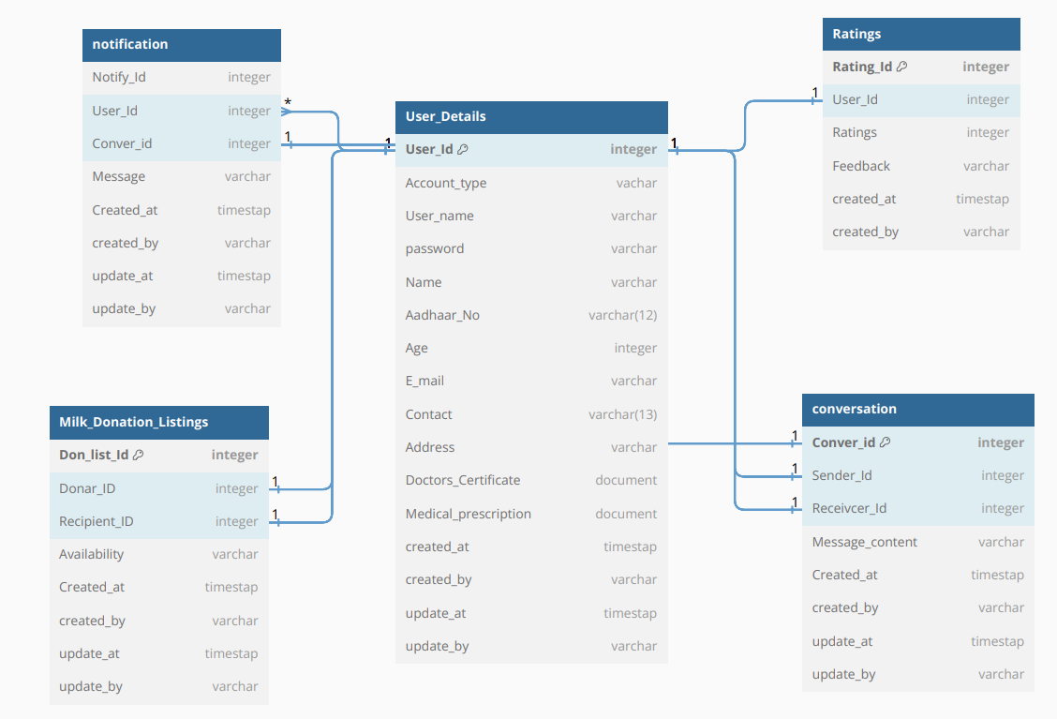
DB Diagram and Entities
Entities :
User Details
Donation
Notification
Conversation
Ratings

Slide 8
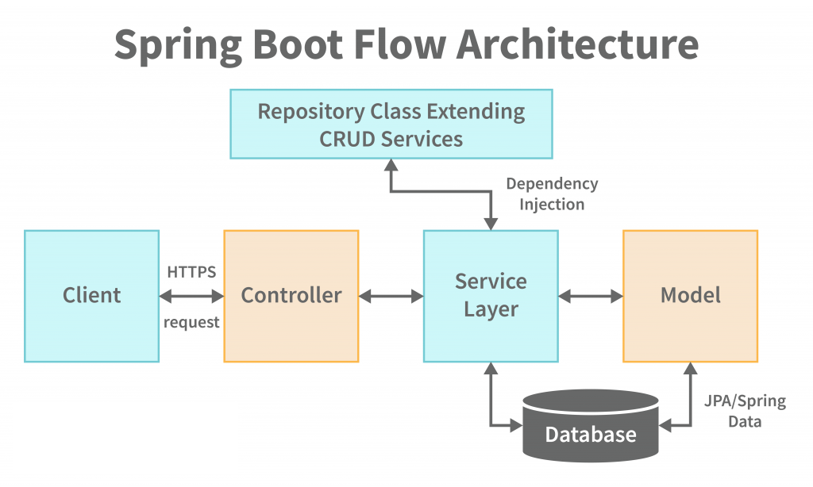

Slide 9
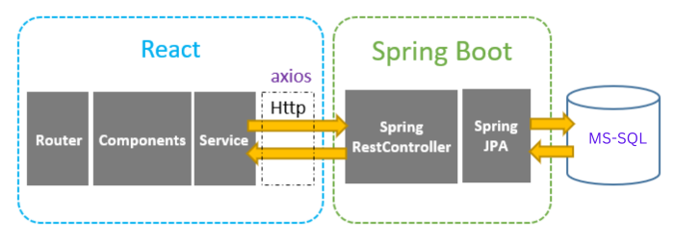
METHODOLOGY

Slide 10
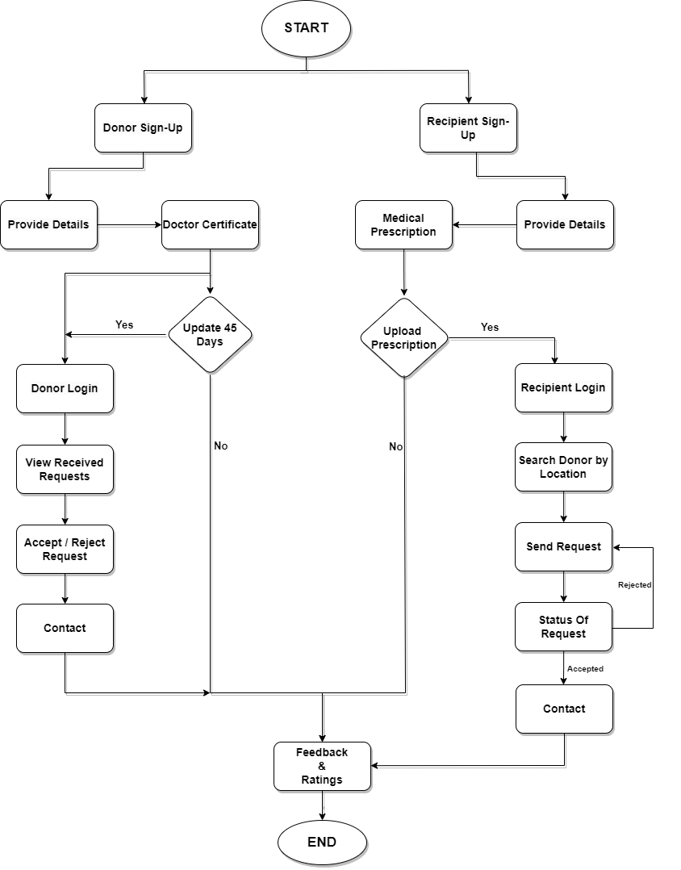
BLOCK DIAGRAM

Slide 11
APPLICATION & OUTCOME
Infant Support:
Connecting Breastmilk Donors for Improved Infant Nutrition
Blood Donation:
Timely Access to Transfusions for Improved Health Outcomes
Organ Donors:
Increased Availability of Organs for Life-Saving Transplants
Community Building:
Fostering Emotional and Social Support
Positive Impact on Infants, Individuals, and the Community
Saving Lives, Improving Health Outcomes
Fostering a Culture of Generosity and Compassion

Slide 12
Technology Stack
Technology Stack:
React (Frontend)
Java Spring Boot (Backend)
MySQL (Database)
Python (Scikit-learn, TensorFlow/PyTorch for ML)
AWS or Heroku (Deployment)
RESTful APIs, Git, Docker, HTML/CSS/JavaScript, Spring Data JPA, Hibernate (Additional Technologies)

Slide 13
SCHEDULE OF ACTIVITIES
First Review
Working on Data.
Making the UI/UX design.
Database Design.
Second Review
Front end using react.
creating backend api’s.
Integrating Ml model.
Mock Review
Full stack web application deployment.

Slide 14
THANK YOU

